Slide 1
NDUBCC Member Role Hierarchy
Streamlining Club Management: A Database-driven Member Hierarchy System for the Notre Dame University Bangladesh Computer Club
by – Tasdiqul Huq (06) and Esha Silvia Rozario (04)

Slide 2
Objective
Develop a user-friendly system to manage the University Computer Club's member hierarchy and related information.
Utilize a database management system (DBMS) to streamline administrative tasks and enhance communication within the club.
Improve organization and accessibility of member data, fostering a more efficient and connected club experience.

Slide 3
Motivation
The proposed member hierarchy system offers:
Centralized database: Securely store and manage member information in a single, accessible location.
Automated communication: Streamline communication by sending targeted emails or notifications to specific member groups.
Enhanced reporting: Generate reports on member demographics, activity levels, or specific cohorts.
Improved organization: Facilitate effective leadership transitions and track member progress within the hierarchy.

Slide 4
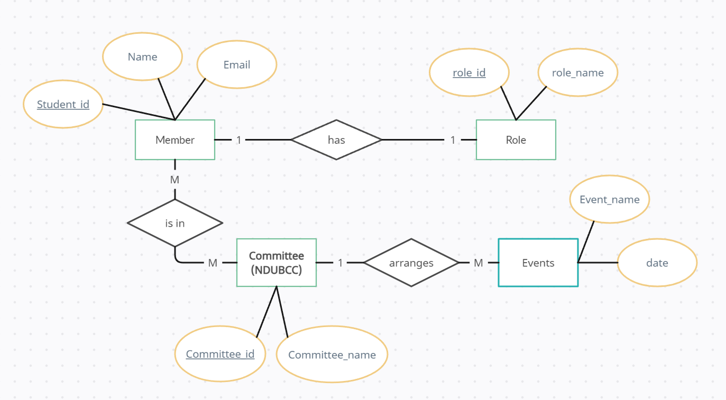
Entity-Relationship Diagram (ERD)

Slide 5
Database Schema
Member
member_id
name
email
student_id
year
Committee
Role
committee_id
committee_name
role_id
role_name
Events
Event_name
date
Member_Role
Member_Committee
member_id
role_id
start_date
end_date
member_id
committee_id
Committee_Events
committee_id
Event_name

Slide 6
Conclusion
Increased efficiency: Streamlined administrative tasks, improved communication, and easier data access.
Enhanced organization: Clear member hierarchy, better tracking of member progress, and smooth leadership transitions.
Improved communication: Targeted messaging and efficient information dissemination to specific member groups.
Scalability: Adaptable to accommodate future growth and changes within the club.

Slide 7
THANK YOU

